Slide 1

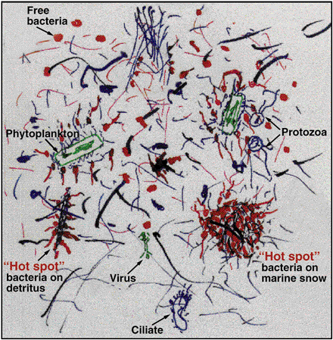
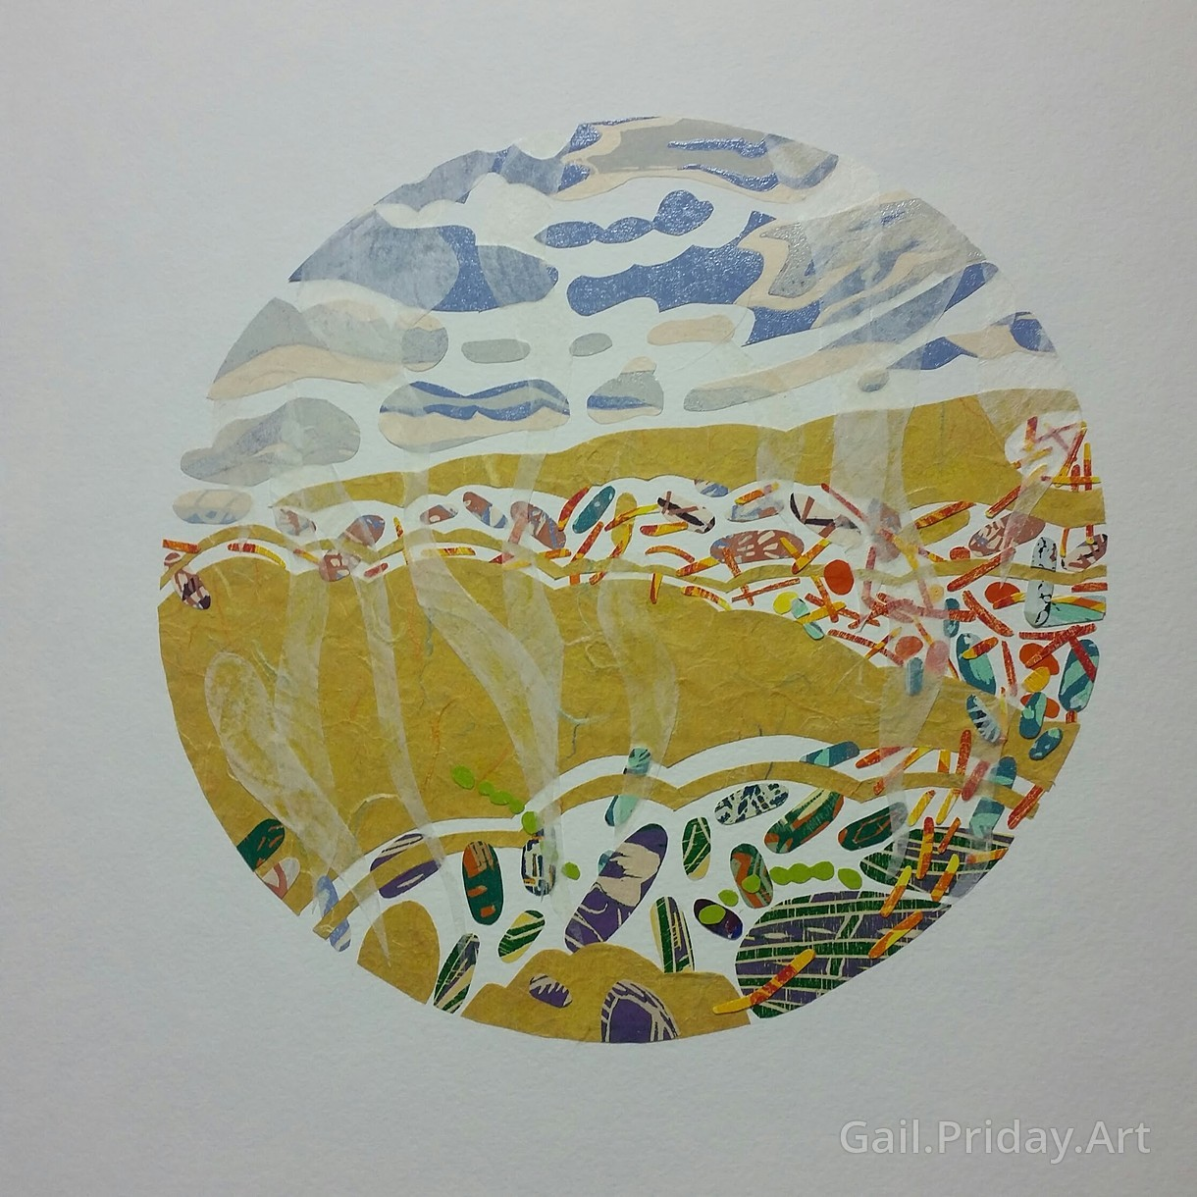
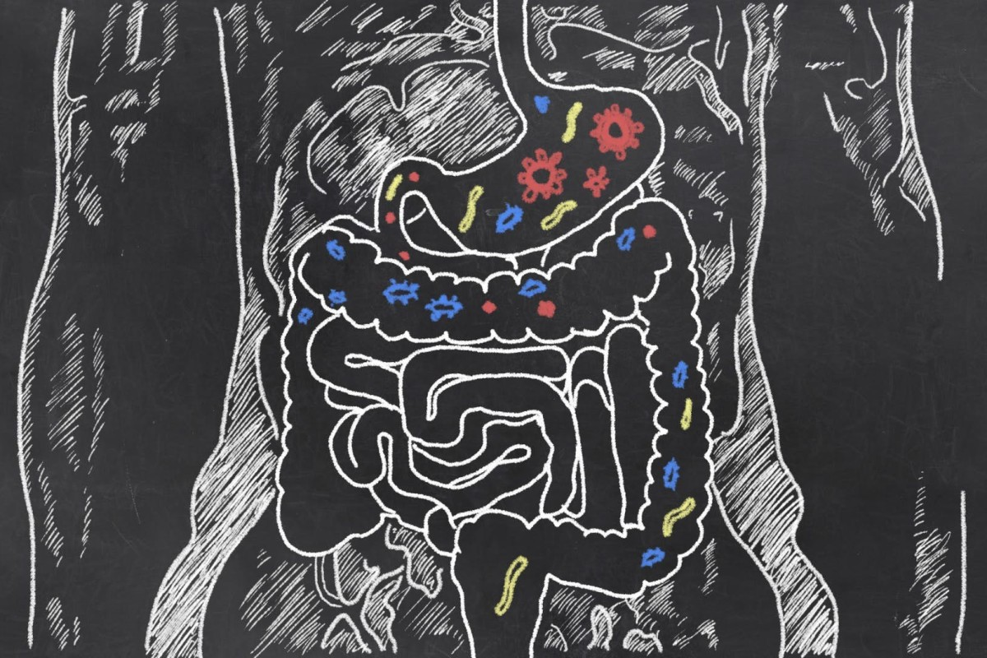
Metagenomics Lesson 2
biovcnet.github.io

Slide 2
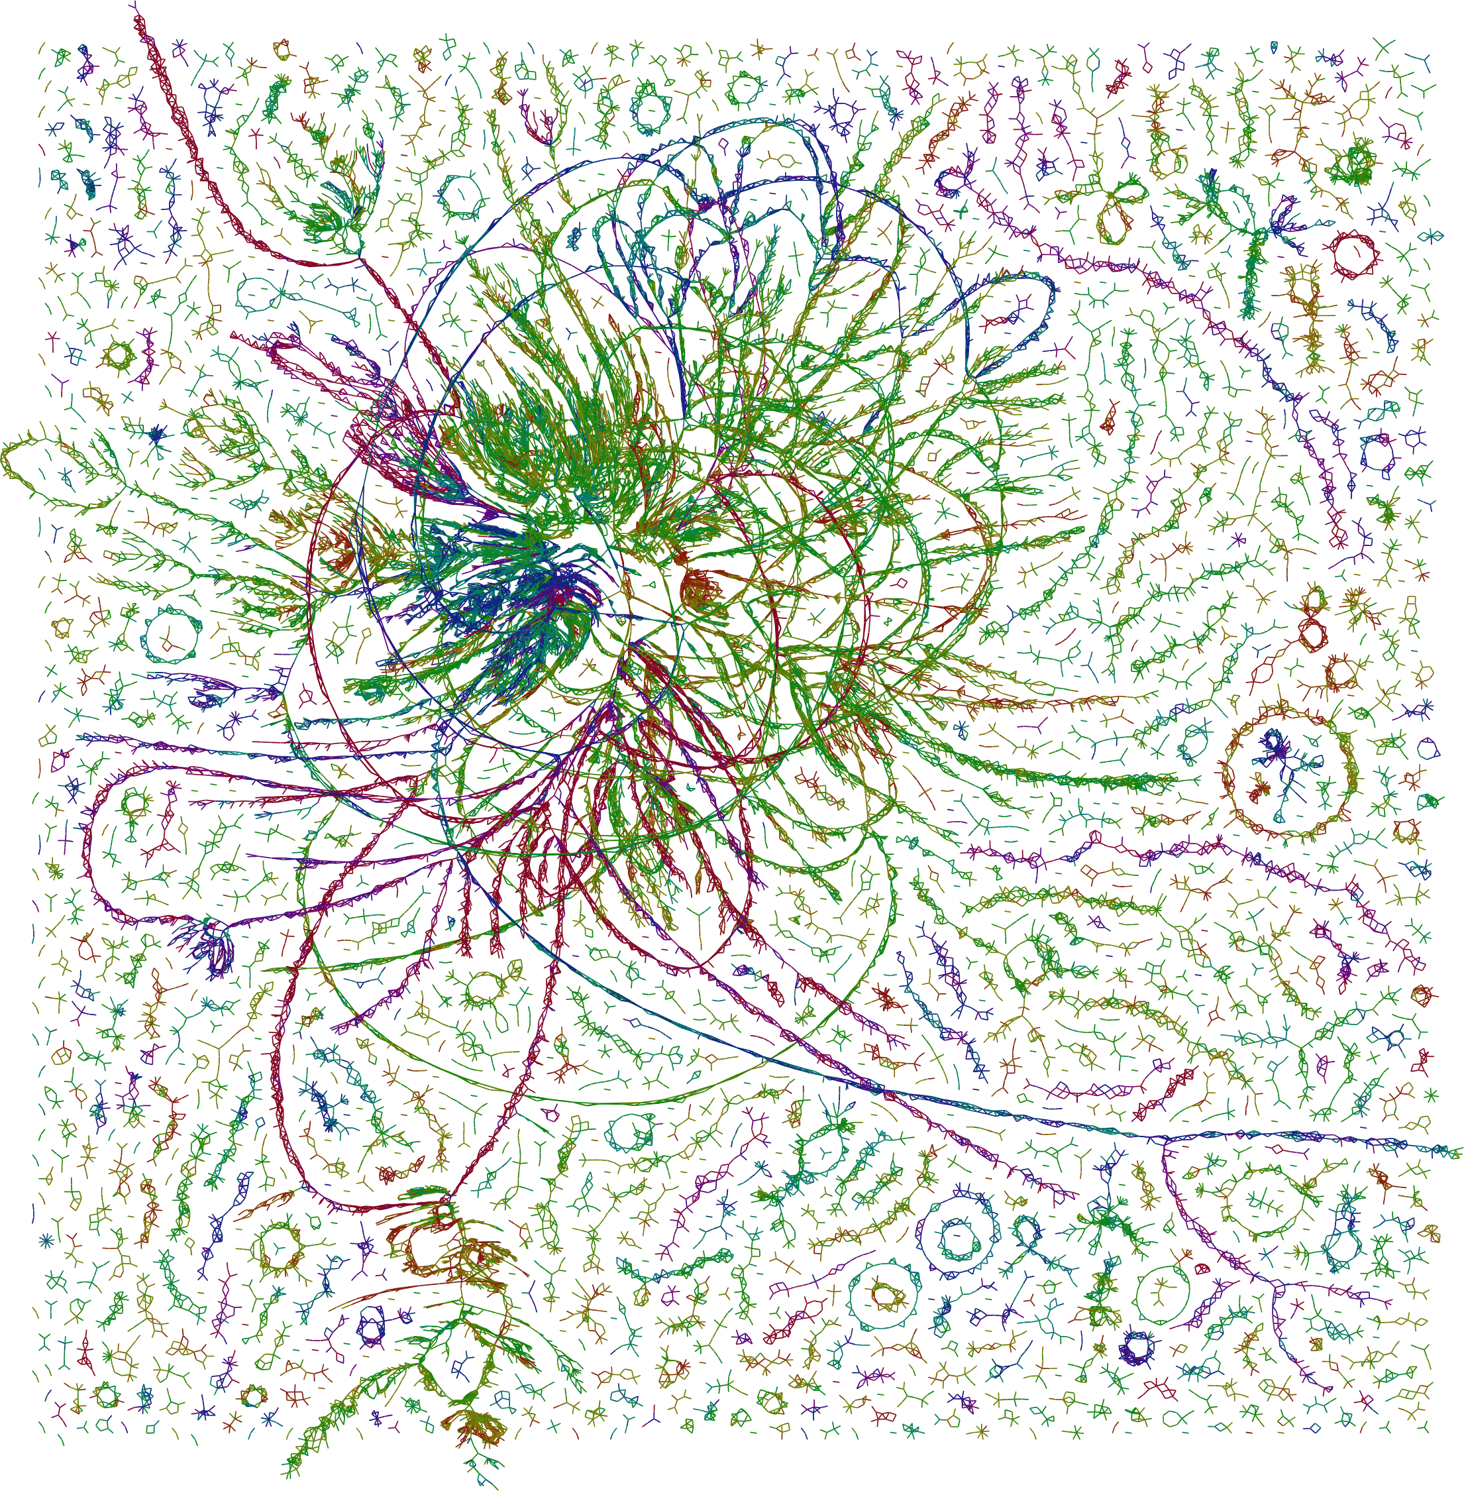
Metagenomics Lesson 2
Taxonomic Classification using k-mers
The power of k-mers
Choosing a classifier
Demo: Adapter trimming
Demo: Kraken2

Slide 3
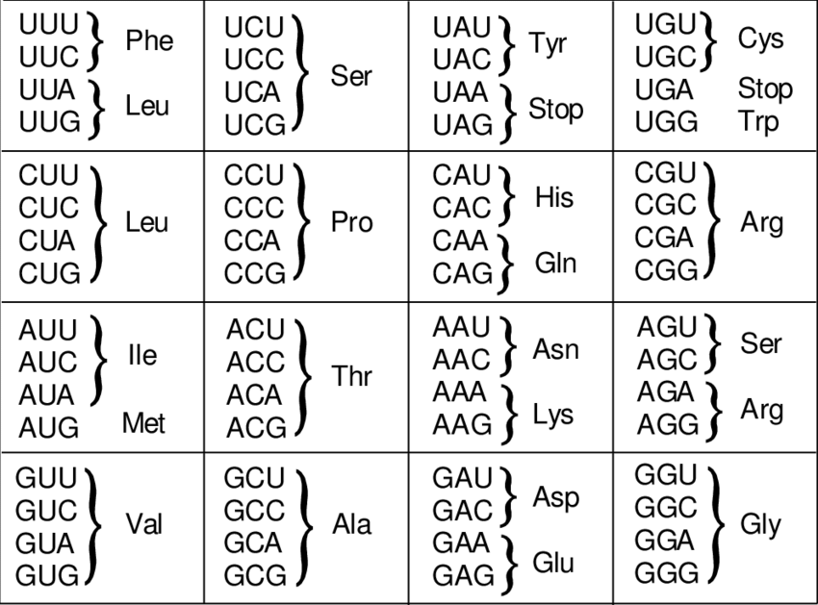
A “k-mer” is a word of DNA that is k bases long
4¹ 1-mers: A, T, C, G
4² 2-mers: AA, AT, AC, AG, TA, TT, TC, TG, CA, CT, CC, CG, GA, GT, GC, GG
4³ 3-mers:
All codons are 3-mers but not all 3-mers are codons

Slide 4
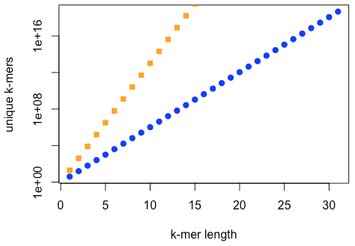
Exponential growth of nucleotide and amino acid k-mers
4¹ = 4
4² = 16
4³ = 64
4⁴ = 256
4⁸ = 65536
4¹⁶ = 4294967296
4³² = 18446744073709551616

Slide 5
Extracting kmers
Typically k-mers are extracted by running a k-length window across all of the reads and sequences.
Given a sequence of length 16, you could extract 11 k-mers of length 6 from it like so:
AGGATGAGACAGATAG
AGGATG
GGATGA
GATGAG
ATGAGA
TGAGAC
GAGACA
AGACAG
GACAGA
ACAGAT
CAGATA
AGATAG

Slide 6
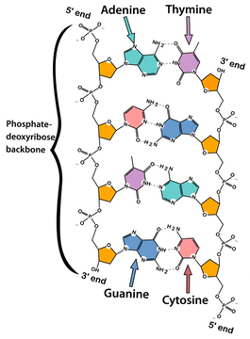
Complementarity
k-mer analysis is often simplified by storing (“hashing” or “indexing”) only the lexicographically lower reverse complement (the “canonical” string), i.e. we can equally choose to store ACTG or CAGT in the picture to the right (reading 5’ to 3’).
TTTT → AAAA
TATA → TATA
CGAT → ATCG
TGAC → GTCA

Slide 7
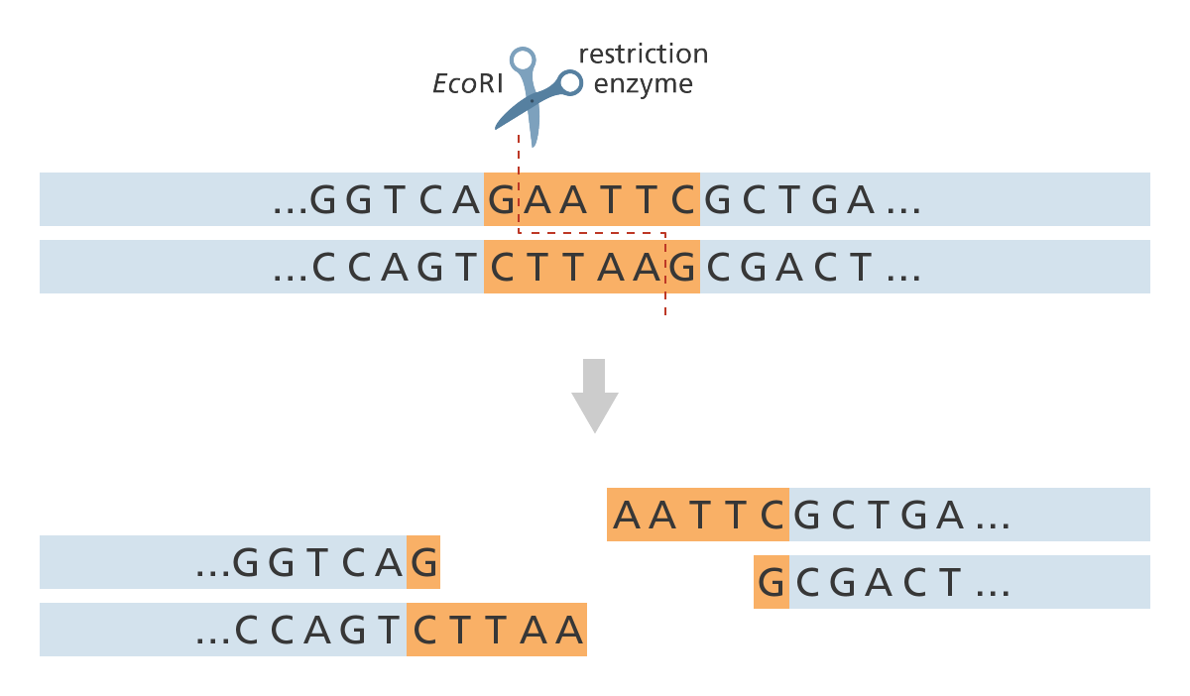
Palindromes
In molecular biology, a palindrome is “a DNA sequence that is its own reverse complement”.
Restriction enzyme cut sites are common examples of palindromes, e.g. EcoRI:
Some tools (particularly assemblers) require odd-length k-mers to avoid palindromes, which induce self-loops in de Bruijn graphs.
An odd-length k-mer can never be its own reverse complement:
5'- G A T T C -3'
3'- C T A A G -5'

Slide 8
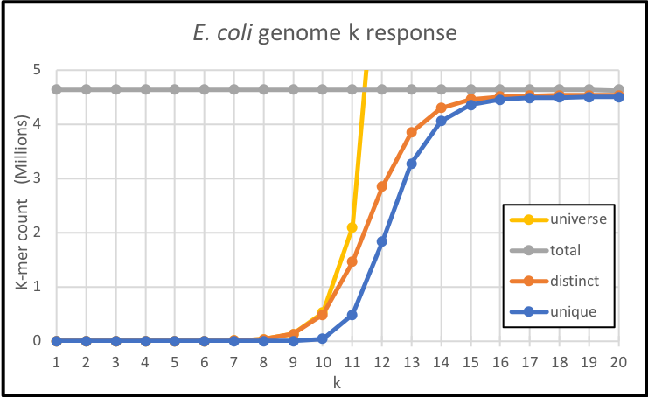
Choosing a k-mer length
The optimal k-mer length will be determined by the goal of your analysis.
1-mers: GC-content analysis
3-mers: Codon usage
4 or 5-mers: Metagenomic binning
7 to 35-mers: Taxonomic Classification
21 to 127-mers: Genome assembly
Bernardo J. Clavijo

Slide 9
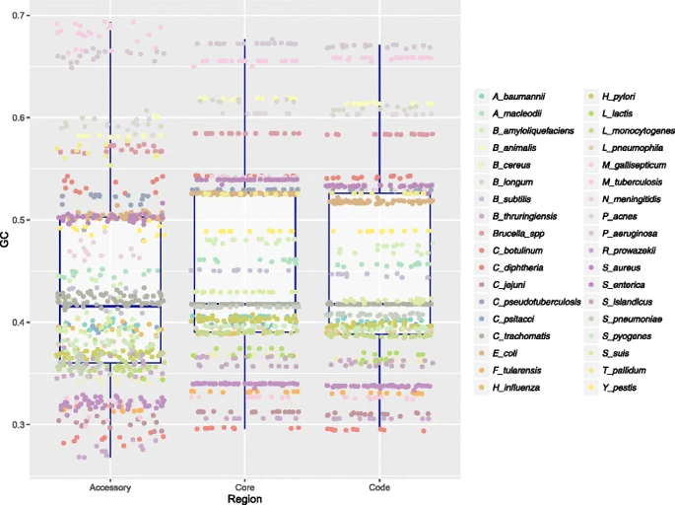
G+C content
The distribution of k-mers in genomes is not uniform.
Even at the level of 1-mers (e.g. G+C, A+T) bacterial genomes have different, but highly conserved proportions.
This figure shows how GC content is distributed in the core, accessory and whole genome regions of some bacteria. The standard deviations are generally a couple percent.
Bohlin et al. 2017

Slide 10
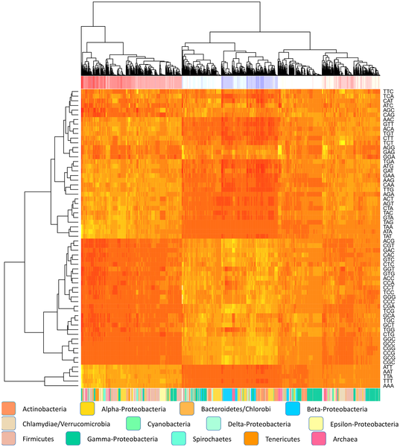
Codon usage
At the level of 3-mers, bacterial genomes have unique, but highly conserved usage of codons. This extends also to untranslated regions and may be primarily related to GC content.
This heatmap shows more (yellow) and less (red) frequently used codons (rows) in some bacterial genomes (columns). AT-rich (red) and GC-rich (blue) genomes are shown in a row at the top.
Bohlin et al. 2013

Slide 11
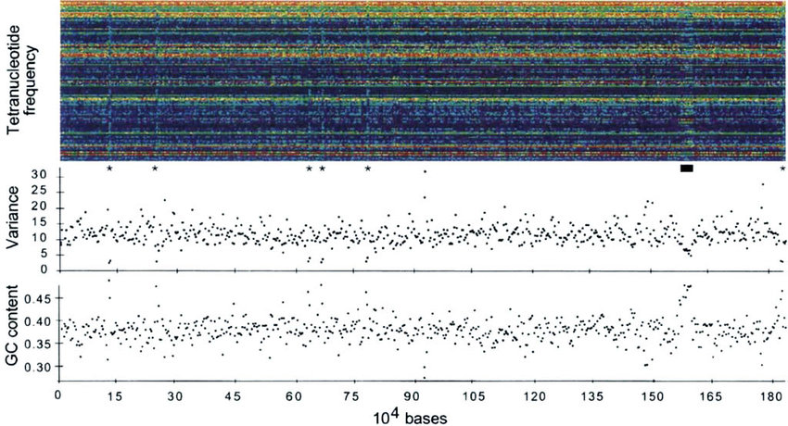
Tetranucleotide Frequency
At the level of 4-mers (aka “tetranucleotide frequency”), bacterial genomes have conserved “fingerprints” which are used in metagenomic binning tools and to detect horizontal gene transfer events.
This figure shows an H. influenzae genome, where each column is the 4-mer fingerprint of a 3000 bp region and each row is a 4-mer colored from low abundance (purple) to high (red).
Starred (*) sections contain ribosomal RNA. The black bar identifies a bacteriophage.
Noble et al. (1998).

Slide 12
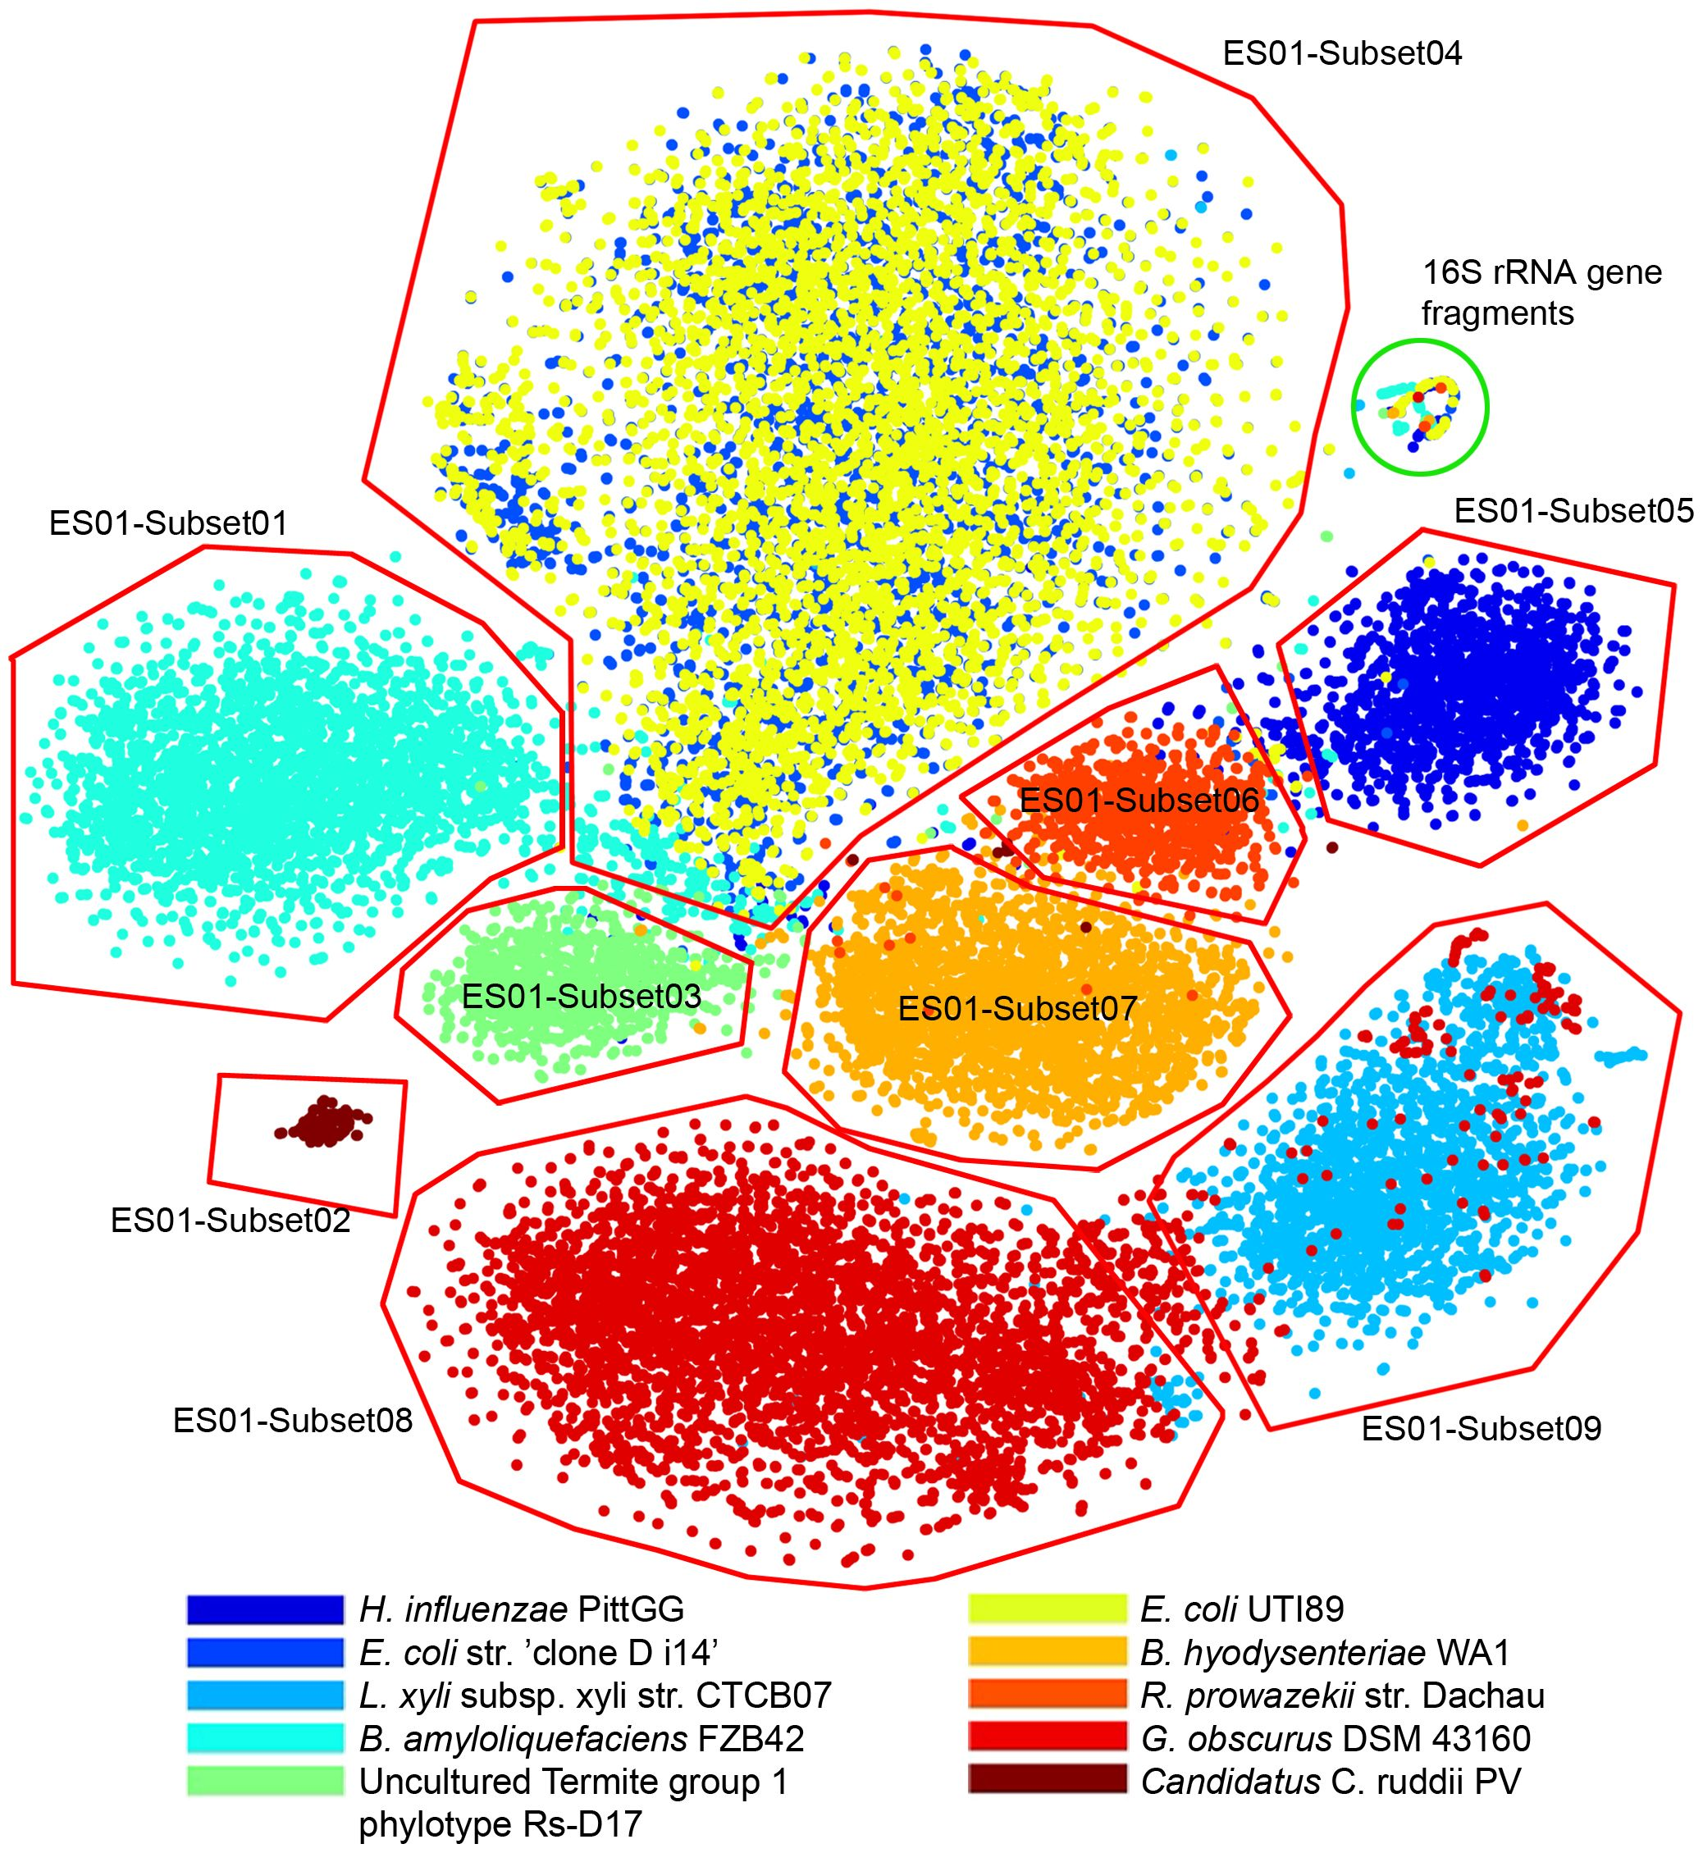
Dimensional reduction
As the number of dimensions increases rapidly with the length of the k-mer, dimensional reduction algorithms like PCA, t-SNE, DBSCAN, and UMAP can be used to project (or “embed”) them back into 2D for visualization.
This figure shows a 4-mer t-SNE-based visualization and human-augmented binning of an evenly distributed simulated microbial community.
Laczny et al. (2014)

Slide 13
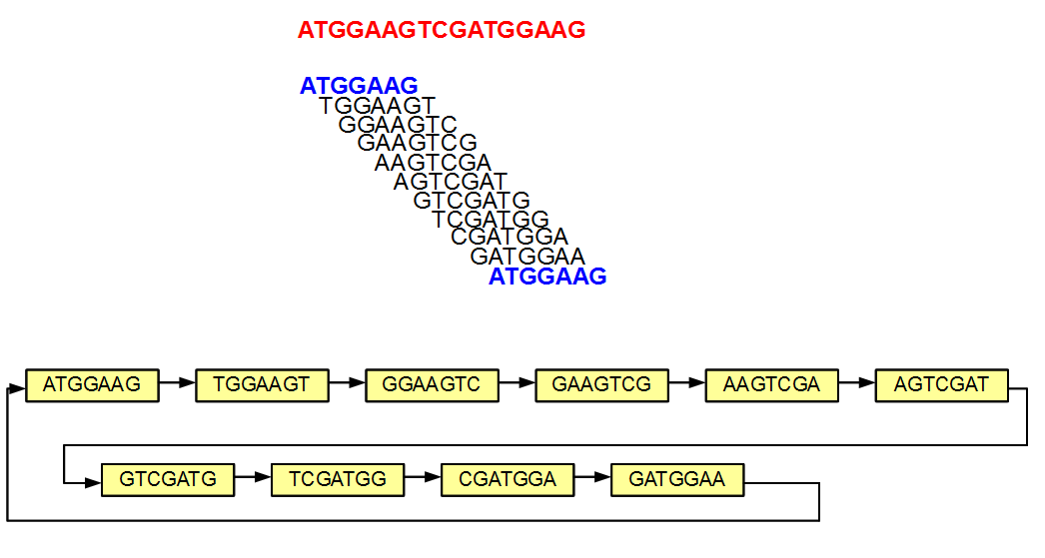
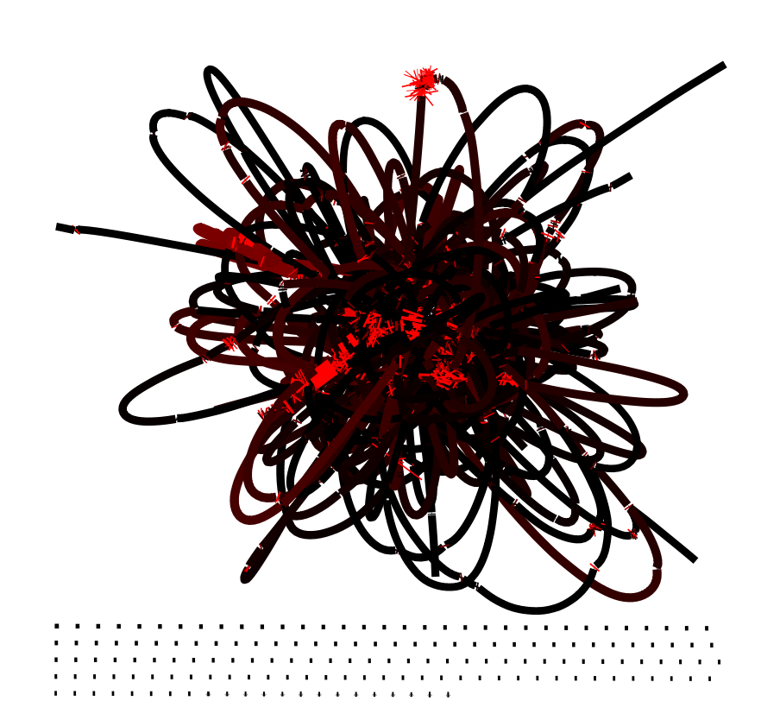
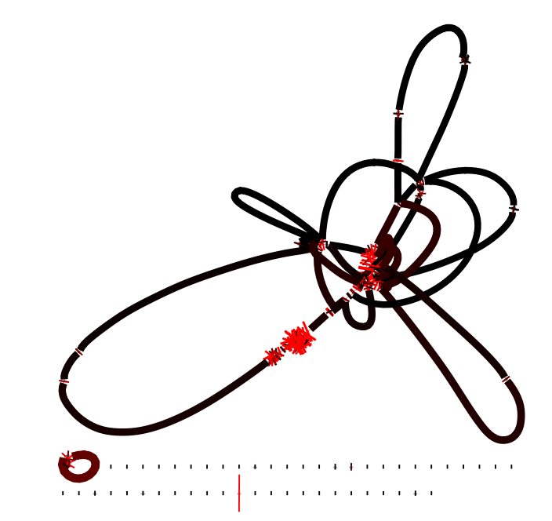
Genome Assembly
If the k-mer length is too short, many unrelated regions are assembled together.
But k-mers cannot be longer than sequence lengths, thus the benefit of long-read technologies.
Many genome assemblers use de Bruijn graphs based on k-mer overlap.
https://homolog.us/Tutorials/book4/p2.1.html
k = 21
3190 contigs
k = 127
288 contigs

Slide 14
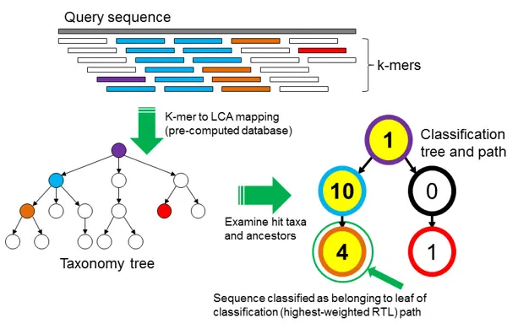
Taxonomic Classification
As k-mer length increases, the probability of a random match between two distantly related taxa decreases exponentially.
This can be used to classify DNA sequences based on their k-mer profiles by comparing the k-mers to a pre-computed database of taxonomically-known k-mers.
This technique is also used for identifying adapters and other contaminants in raw reads.
Wood & Salzberg (2014)

Slide 15
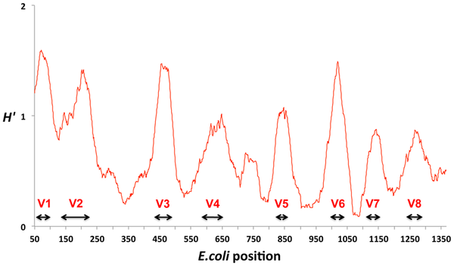
Choosing a Metagenomic
Taxonomic Classifier
Sequence format
Nucleotide k-mers grow at 4^{x}
Amino acid k-mers grow at 20^{x}
So a nucleotide 31-mer = Amino Acid 14-mer
Database
Whole genomes
Marker genes
Ribosomal RNA genes
Search algorithm
k-mer indexing
MinHash (Lesson 3)
BWT (Lesson 4)
BLAST-like (#FunctionalAnnotation)
Variance in nucleotide composition in 16S ribosomal RNA genes. Vasileiadis et al. (2012)

Slide 16
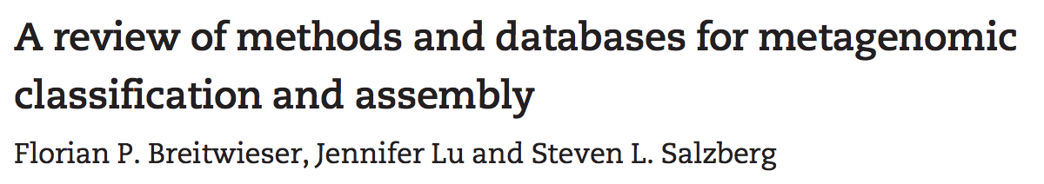
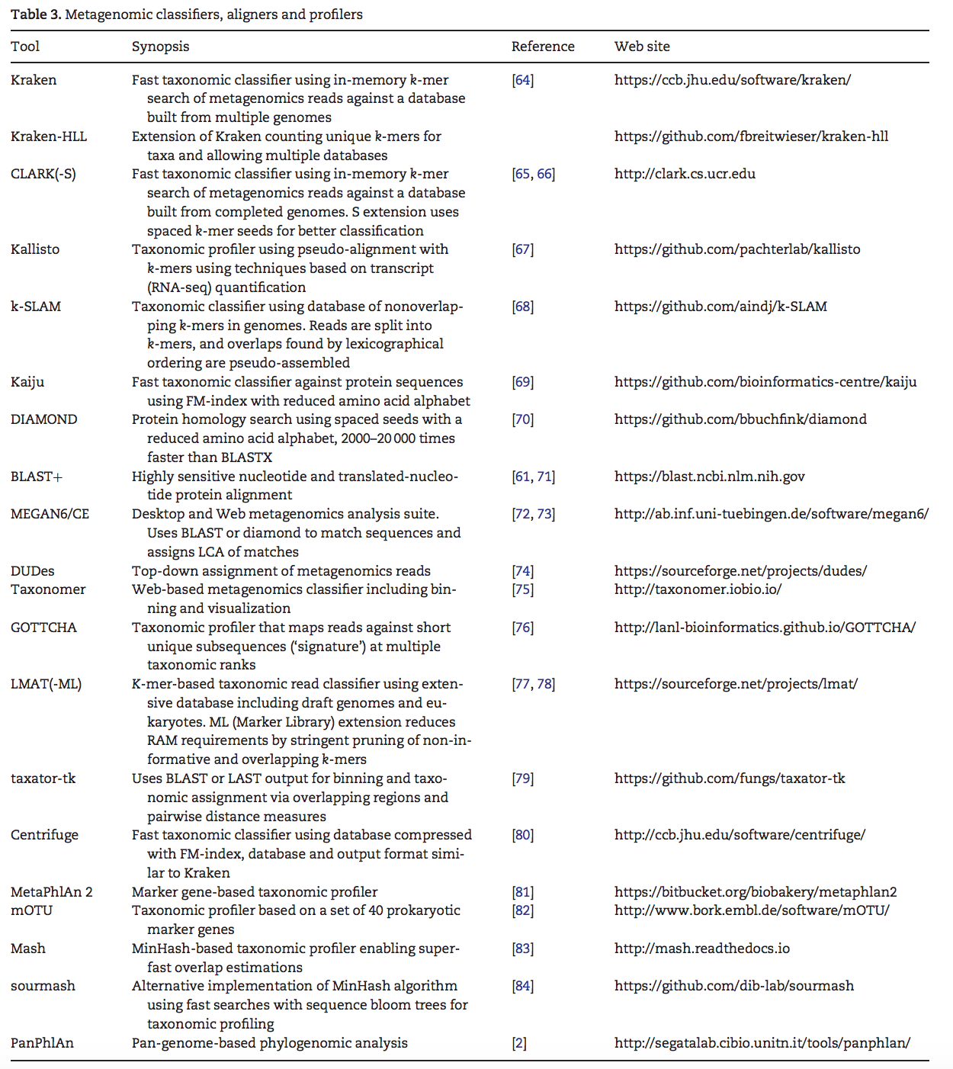
Choosing a Metagenomic
Taxonomic Classifier
k-mers + genomes
Kraken (don’t use anymore!)
Kraken2 (nuc or aa)
KrakenUniq (nuc)
CLARK (nuc)
MOTHUR classify.seqs (16S rRNA)
BWT + genomes
Centrifuge (nuc)
Kaiju (aa)
BWT + marker genes
MetaPhlAn2
mOTU
AMPHORAnet

Slide 17
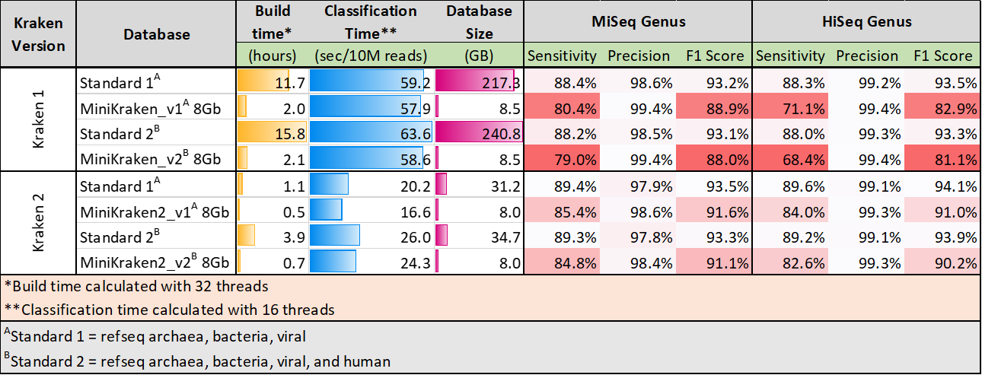
Demo #2 by Eric Collins on k-mer-based trimming (bbtools) and taxonomic classification (kraken2)

Slide 18
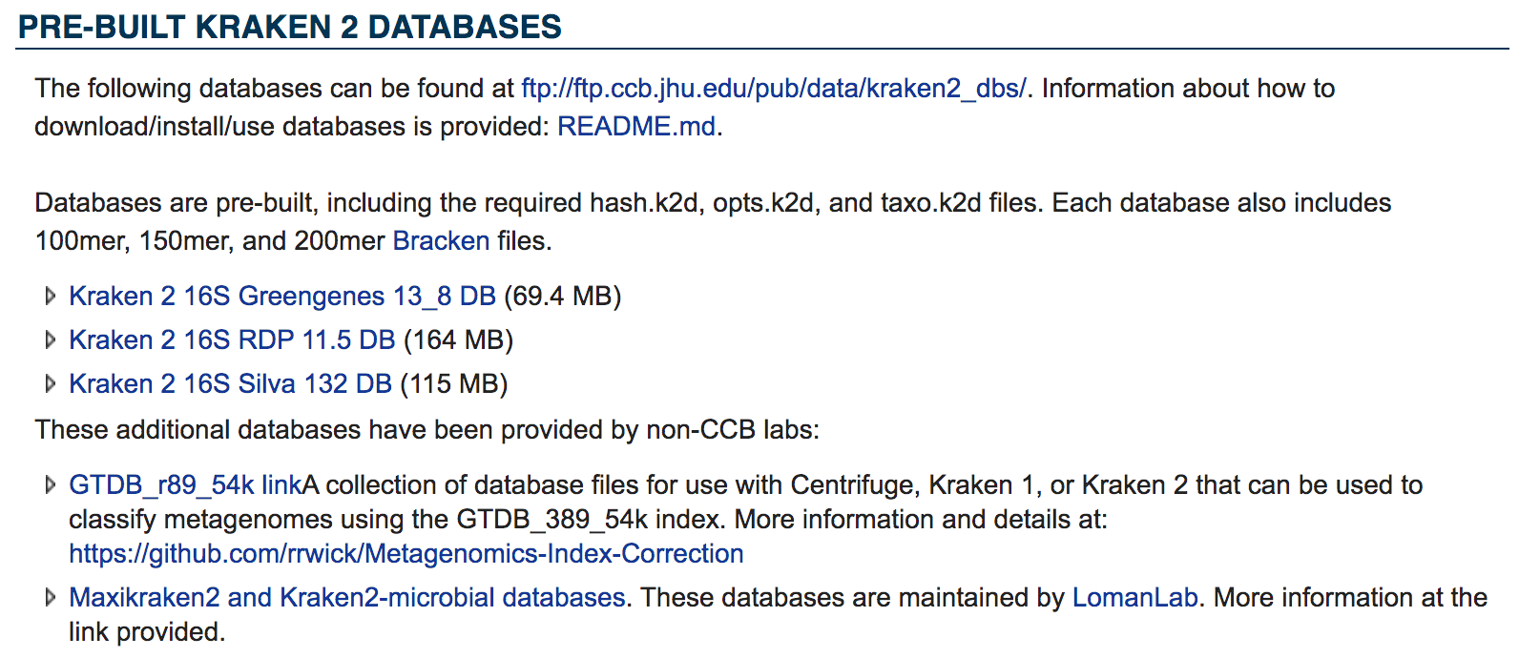

Slide 19
Additional Resources
[C. Titus Brown] A post about k-mers - this time for taxonomy!
[Jennifer Lu et al.] How to Choose Your Metagenomics Classification Tool
[Bernardo J. Clavijo] k-mer counting, part I: Introduction
De Bruijn graph of a genome
Comparing datasets using sourmash

